Slide 1
DE&I (Diversity, Equity & Inclusion)
Group confidential
Human Resources Division

Slide 2
Purpose of this course
Understand what DE&I is.
Understand the IHI Group’s goal of DE&I promotion.
Consider what each of us can do to practice DE&I.

Slide 3
Introduction
“DE&I” is the idea of “creating an environment and a corporate culture where people of different ages, genders, backgrounds, personalities, and values, respect each other and maximize their own characteristics and abilities”.
The promotion of DE&I is essential for IHI Group to find business opportunities to solve social issues and achieve sustainable growth.
Let's learn about "DE&I" through this course.
DIVERSITY
EQUITY
INCLUSION

Slide 4
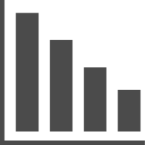
1. The need for DE&I
The environment surrounding companies continues to change rapidly, with increasing uncertainties such as the international affairs and the worsening of labor shortages due to the declining birthrate and aging population in Japan.
If we only follow the changes, it will be difficult to maintain the current status, let alone achieve sustainable growth.
Population
Economy and politics
Society
- Low birthrates and aging populations
- Decrease in working-age population
- Expansion of immigrant workers
- Economic globalization
- Rapid development of technology
- Corporate Governance
- Diversification of customer needs
- Diversification of employment status
- Climate change and conflict risks
In order for a company to survive, it is necessary to make the best use of the strengths and individuality of diverse human resources. We need to adopt new perspectives and respond to uncertain flexibly to unforeseen circumstances.

Slide 5
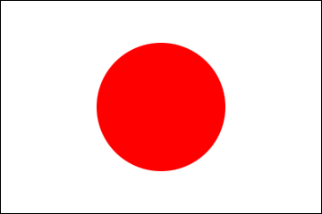
1. The need for DE&I
In the “Gender Gap Index” published annually by the World Economic Forum, Japan ranked 125 out of 146 countries in 2023, the lowest ranking in the past, with a large gender gap in “economy” and “politics”. In particular, the low ratio of women in manager positions is ranked lower in the world.
Gender Gap Index 2023
Gender Gap Index 2023
Compiled from the World Economic Forum (Global Gender Gap Report 2023)
Lowest
in G7
Rank
Gap index
125
Economy
123th / 0.561
th place
Politics
138th / 0.057
Education
47th / 0.997
146 countries
HEALTH
59th / 0.973
We need to take this situation and create an environment where each individual can work in our own way and take on the challenge of what we want to do, starting with the elimination of gender gaps within the companies.

Slide 6
2. IHI Group’s goal for DE&I promotion
Based on respect for human rights as a corporate responsibility, IHI Group will work to foster an organizational culture that emphasizes DE&I, which will lead to sustainable growth.
Fostering an organizational culture that links the power of diversity to value creation
Promote DE&I and lead to sustainable corporate growth.
Sustainable growth
Understanding diversified needs
Identify business opportunities by capturing society’s problems and customer needs
Driving innovation and change
The experience and values of our diverse human resources bring new perspectives into the organization
Respect for human rights as a corporate responsibility
Human rights as the foundation for promoting DE&I
To make diversity meaningful, we begin by respecting human rights.
Environments in which the human rights of diverse human assets are respected form the foundation for promoting DE&I.

Slide 7
2. IHI Group’s goal for DE&I promotion
We are working to create a work environment in which opportunities are fairly open and in which each individual‘s strengths are leveraged, taking into account differences in such factors as their position, living environment, and gender. The following are major initiatives.
Creating an organizational culture
Providing opportunities for diverse experiences
Messages from Top Management
Implementation of DE&I training
Campaigns to raise DE&I awareness
Rotation between divisions, dispatch of outside training
Intra-Group Recruitment (Career Challenge)
Side business outside the company and inside the company
Developing diverse human resources
Reform work styles and business processes
Aggressive career hiring
Active recruitment, training and promotion of female employees
Training for foreign employees and cross-cultural exchange meetings
Recruitment of employees with disabilities and establishment of support system
Creating a workplace free of sexual orientation and gender identity
Promotion of term employees to regular employees
Support system and consultation service for balancing work and family care
Promotion of diverse work styles (telecommuting system, etc.)
Creation of new work styles (smart work)

Slide 8
3. What is DE&I?
“DE&I” is the idea of “creating an environment and a corporate culture where people of different ages, genders, backgrounds, personalities, and values, respect each other and maximize their own characteristics and abilities”.
From the next page, we will explain each meaning.
DIVERSITY
EQUITY
INCLUSION

Slide 9
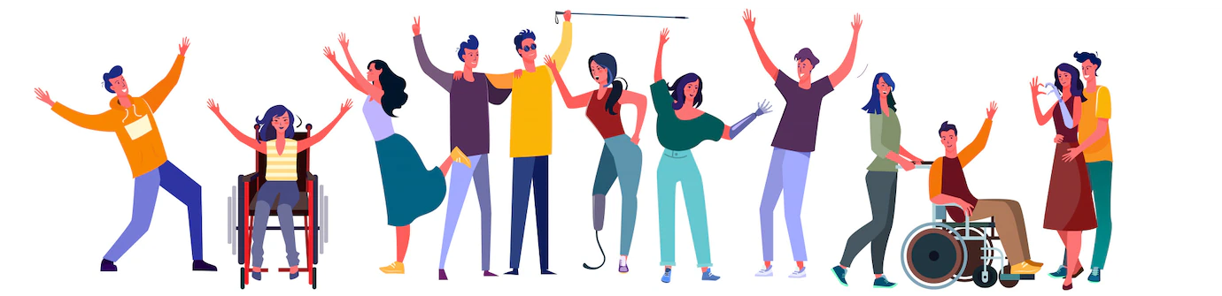
3. What is DE&I?
DIVERSITY
A state in which human resources with diverse attributes are worked together in a group.
Attributes includes age, sex, race, nationality, disability, sexual orientation, gender identity, religion, beliefs, values, career, experience, work styles, and more.
Point
It is important to respect not only visible attributes but also invisible attributes.
Are you trying to understand differences in attributes and values in the workplace?

Slide 10
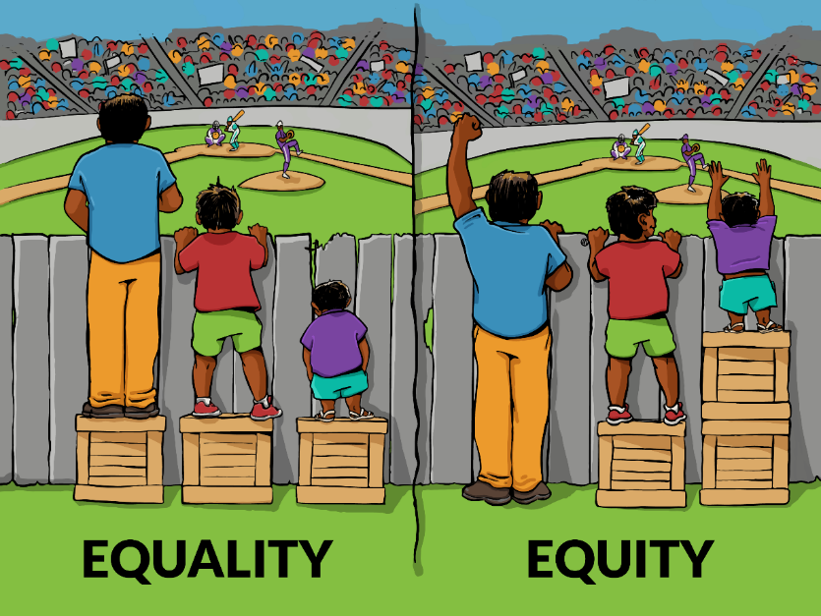
3. What is DE&I?
EQUITY
Equity refers to considering the differences among each of our diverse human resources, coordinate proper support and provide opportunities so each individual has fair chance.
Point
Equity is based on the premise that society has an unequal structure to begin with and that not everyone has the same starting point.
Unlike "equality," which provides the same means to all people in all circumstances, the emphasis is on creating an equitable environment and system and operating it fairly, taking into account the differences and circumstances of each individual, and the objectives of the activity.
Are there opportunities for growth and career advancement for any person?
Rather than equality in means (wooden boxes),
Whether it is fair when considering the purpose (watch the game)

Slide 11
3. What is DE&I?
INCLUSION
Inclusion refers to recognizing the individuality of diverse human resources and making the most of their differences.
Diversity
A state where people with diverse attributes gathered
Inclusion
A state where individuality is recognized and being able to demonstrate abilities
Point
It is important to realize an environment (psychological safety) in which each individual can maximize their own unique characteristics and abilities.
Inclusion is not about avoiding conflict and pleasing others.
Is there an atmosphere of respect for people with different points of view in your workplace?
Are decisions being made that make the most of diverse perspectives?

Slide 12
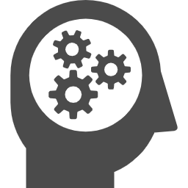
4. Thinking by Individuals to Practice DE&I
Workplace where DE&I are promoted improves the engagement and productivity of employees. It also attracts talented personnel as a place where a diverse range of human resources can play an active role.
In the workplace, it is important to create an open and vocal workplace by always remembering to communicate with a mindset of respect for each individual.
One of the factors that hinder the realization of DE&I in organizations is the existence of "unconscious bias," which is said to be present in all people.
Unconscious bias is a distortion or bias in the way we see things that we are not aware of.
Unconscious bias is present in everyone and is not a problem in itself;
It is important to be aware of your own unconscious bias.
Specific examples will be described on the next page.
Prejudice
Stereotype
Common sense

Slide 13
4. Thinking by Individuals to Practice DE&I
<Similar examples of unconscious bias>
Associate woman when thinking of serving tea, receptionists, clerks, and childcare workers.
I think it is impossible for employees who are raising children to engage in heavy work.
I don't think people who go home on time are motivated.
I think elderly people have a firm mind, and they cannot accept new working styles.
I wonder if a foreigner can accept Japanese corporate culture.
I think people with disabilities are only capable of simple tasks.
I don't think there are any LGBTQ+ people around me.
When we hear "diversity," I think it is about accepting all the differences.
“This is normal,” “This is the common sense,” and “I feel this way, so the other person must have same feelings too” … Those thoughts can affect our ability to judge others fairly.
You could be unconsciously criticizing or putting pressure on others with those thoughts.
“You are not able to do this,” “I should cover this for you,” or “You should be on the same” … It may come from your own assumptions.
Be aware that your way of looking at and perceiving things may be different for the other person.
We should remove our assumptions, pause, and have a dialogue with them.

Slide 14
Summary
DE&I stands for "diversity," "equity," and "inclusion." The idea is to create an environment and a corporate culture where people of different ages, genders, backgrounds, personalities, and values can respect each other and maximize their own characteristics and abilities.
By promoting DE&I, IHI Group will gain a better understanding of diversified needs and drive innovation and change, leading to sustainable growth.
Let's listen to the voices of people who have different perspectives from our own, think together, and work to create a workplace where everyone can work comfortably by utilizing diverse perspectives. Your conscious act is important.

Slide 15
Questionnaire
Please access the following URL and answer the questionnaire. (Access a site outside of IHI-Career)
After answering, please return to IHI-Career and make sure there is a check mark.
https://forms.office.com/r/6w1tRTAkcq
*If you are unable to access the Forms due to network environment, etc., you do not need to answer.

